Slide 1

2017 Computer Graphics Term Project
2017. 06. 07
MG’s Babies
2015410060 최 승 훈
2015410084 정 윤 진
2015410094 권 지 노

Slide 2
목차
1 What and Why?
4 Result
1-1 Aurora Simulation
1-2 Curtain Simulation
4-1 Result Video
4-2 Real Time Demonstration
2 When?
5 Conclusion
2-1 Schedule
2-2 Commit Log
5-1 Review
5-2 Further Points of Improvement
3 How?
3-1 Techniques
3-2 Objects
3-3 Physics Engine
2017 CG Term Project

Slide 3
Chapter 1
What and Why?
2017 CG Term Project

Slide 4
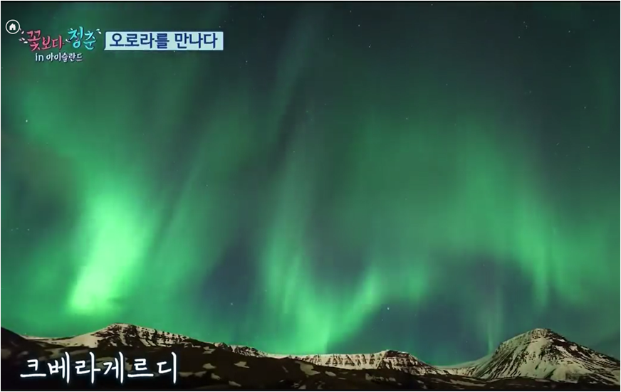
1-1
Aurora
Simulation
오로라의 움직임을 표현
4

Slide 5
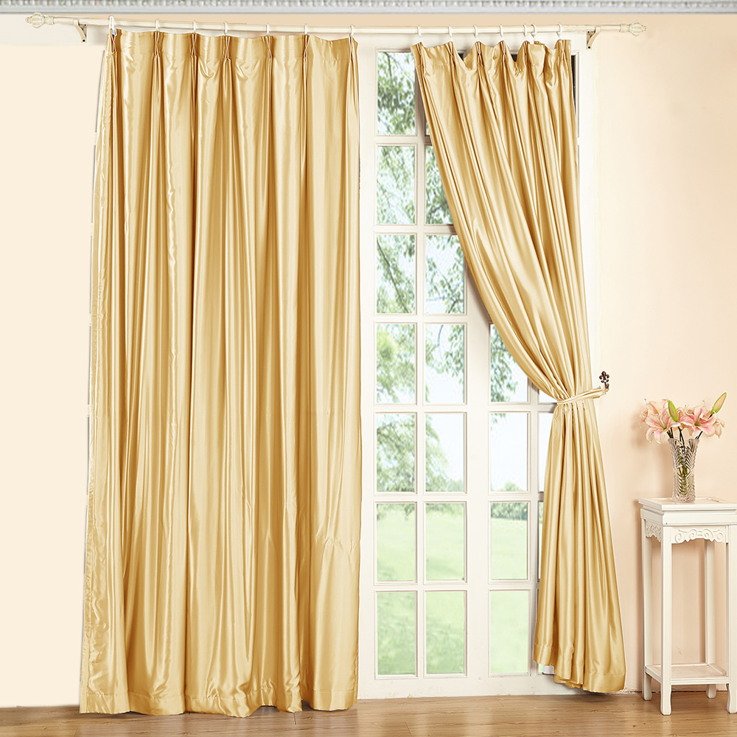
1-2
Curtain
Simulation
방 안에서 커튼의 움직임을 구현
5

Slide 6
Chapter 2
When?
2017 CG Term Project

Slide 7
2-1
Schedule
May 15 ~ May 21 : Aurora Object Finding
May 22 ~ May 28 : Aurora Simulation Implementation
& Subject Change to Curtain Simulation
May 29 ~ June 4 : Implementation of Curtain Simulation
June 5 ~ June 6 : Final Scene Implementation
& Preparing Presentation
7

Slide 8
2-2
Commit Log
8

Slide 9
Chapter 3
How?
2017 CG Term Project

Slide 10
3-1
Techniques
Texture Mapping
Object에 Texture를 입히는 기술
간단히 말해, Object에 사진을 입히는 것
Curtain
Objects in the room
Environments ( room, sky, moon)
Copying Texture Image to object (displaying on TV)
10

Slide 11
3-1
Techniques
Lighting
Default Light : Moon Light
Keyboard ‘F1’ Key : light in the room (on/off)
11

Slide 12
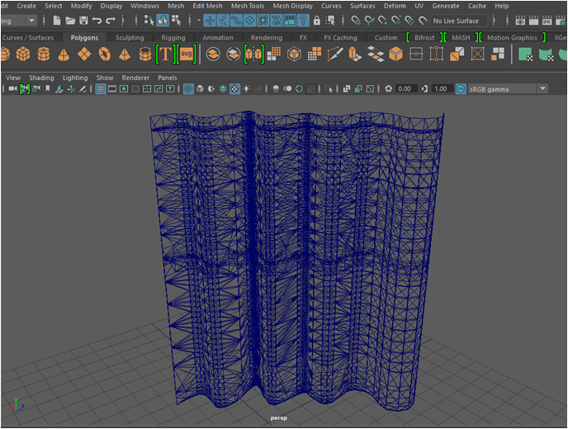
3-2
Objects
Curtain
12

Slide 13
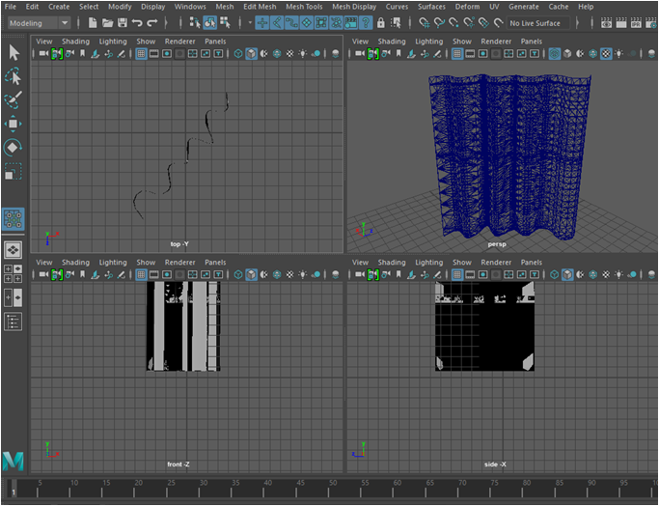
3-2
Objects
Curtain Details
13

Slide 14
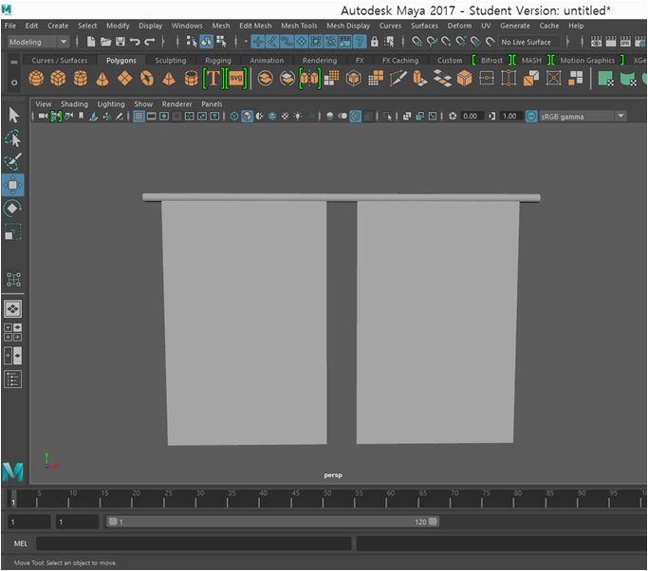
3-2
Objects
Final Model
14

Slide 15
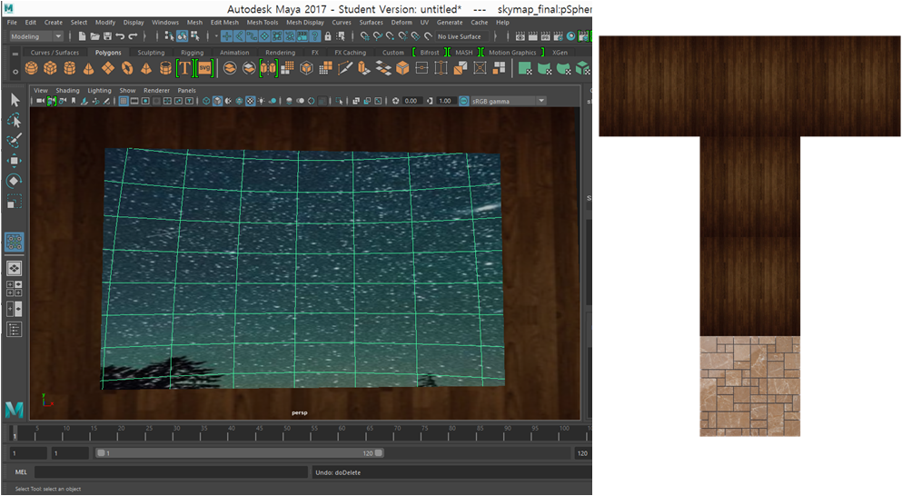
3-2
Objects
Room Model
15

Slide 16
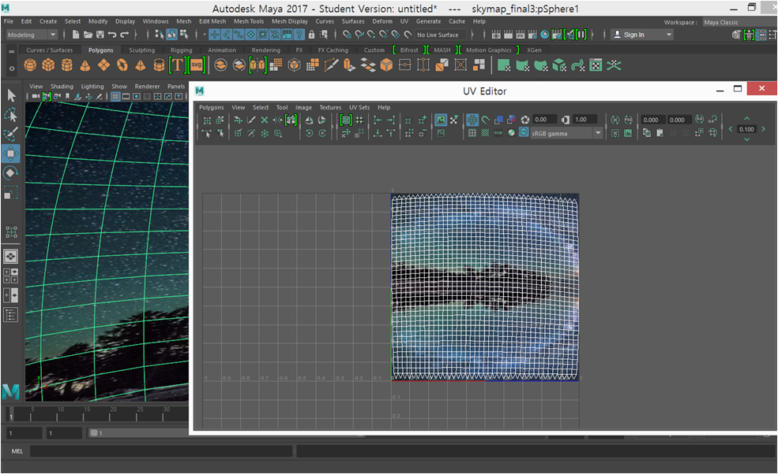
3-2
Objects
Sky Map Modeling
16

Slide 17
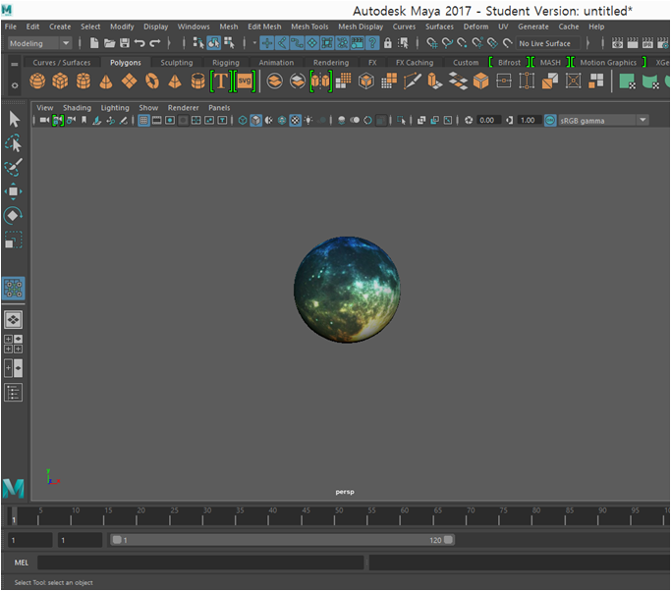
3-2
Objects
Moon Object
17

Slide 18
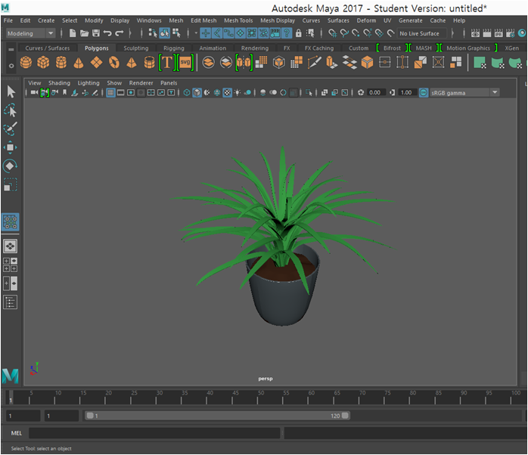
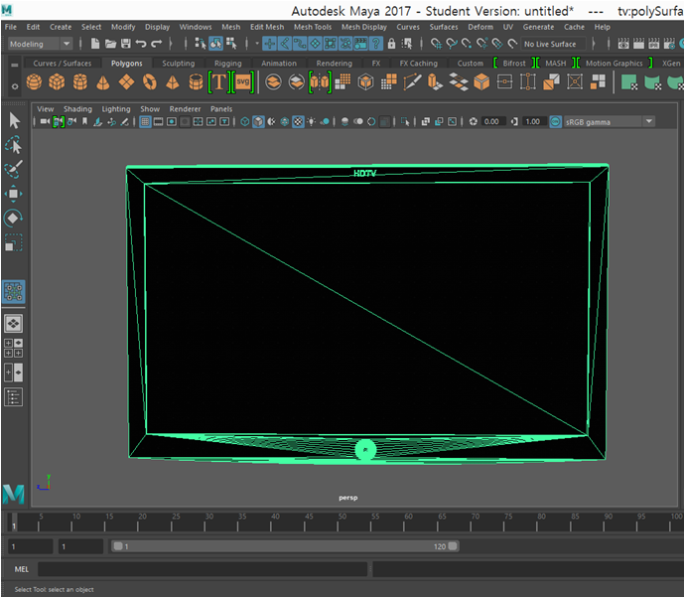
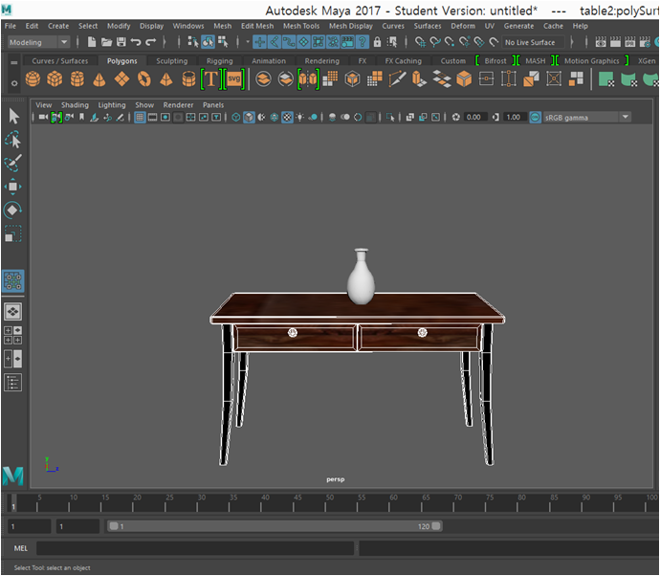
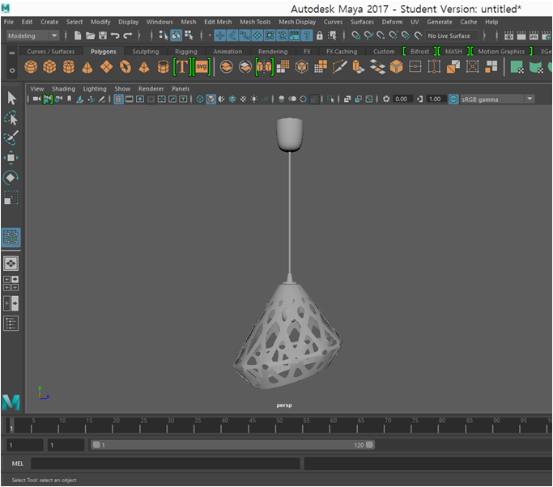
3-2
Objects
Objects In the Room
18

Slide 19
3-3
Physics Engine
Camera Movement
Reacting Asynchronous Key Functions
W, A, S, D : Move position of the camera
Drag : Move the camera view
19

Slide 20
3-3
Physics Engine
Object Picking
Using Back Buffer
Curtain 1, 2 : curtain movement
Otherwise : moving viewpoint by dragging
20

Slide 21
3-3
Physics Engine
Curtain Movement
By Cloth Simulation
cloth simulation effected by gravity (idle)
cloth simulation by dragging the object
→ implementing tension of each particle
21

Slide 22
3-3
Physics Engine
Collision Detection
Using Bounding Box
Curtain ←→ room wall, floor
Detection between two curtains
Camera ←→ room boundary
22

Slide 23
3-3
Physics Engine
Open / Close Curtain
Reacting Asynchronous Key Functions
Holding the location of particle on the bone (spread / fold)
Keyboard ‘O’ : opening the curtain
Keyboard ‘C’ : closing the curtain
By pressing each key, the movement goes on
(using asynchronous key function)
23

Slide 24
3-3
Physics Engine
TV Channeling
Keyboard ‘T’ : turning on / off the TV
Keyboard ‘1’, ‘2’ : changing TV channels
24

Slide 25
Chapter 4
Result
2017 CG Term Project

Slide 26
4-1
Result Video
26

Slide 27
4-2
Real Time
Demonstration
27

Slide 28
Chapter 5
Conclusion
2017 CG Term Project

Slide 29
5-1
Review
Team Project using Github
By using Source Tree, we could learn how to manage sources and processing the whole project
Rendering Quality
We could understand how the rendering quality differs to the numbers of vertexes in the object
Understanding Difficulties of Implementing CGs
We could grasp the hardship of demonstrating SC scene in the games, movies, and etc.
29

Slide 30
5-2
Further Points
Of Improvement
Collision Detection
Collision Detection between objects
Curtain Movement with Wind
If we can implement the movement of curtain with the default wind, the scene will be more realistic
Using Shading Language
Using the GLSL to the scene rendering,
the shading of the object would be more fictional
30

Slide 31
Q & A

Slide 32
Thank You!

